Slide 1
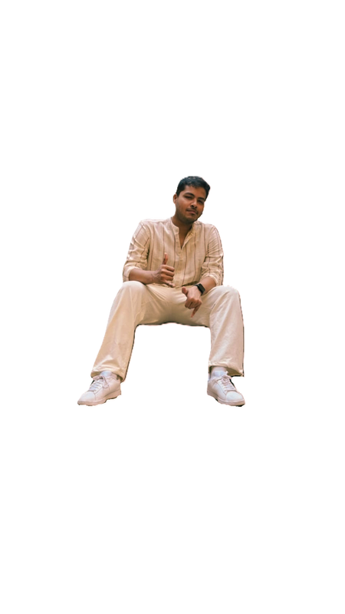
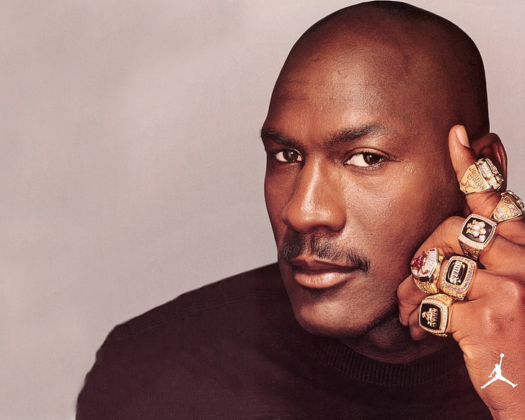



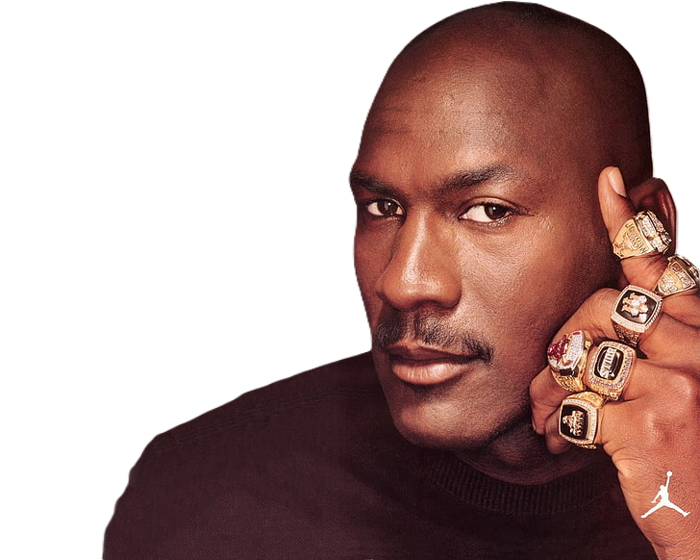

Lord Of
The Rings
QM: Prayag Mohanty

Slide 2




In Memoriam
to our comrades in quizzing (Class of 2026), who’ve fallen to corporate slavery and have been abducted by the siren song of the MBA

Slide 3
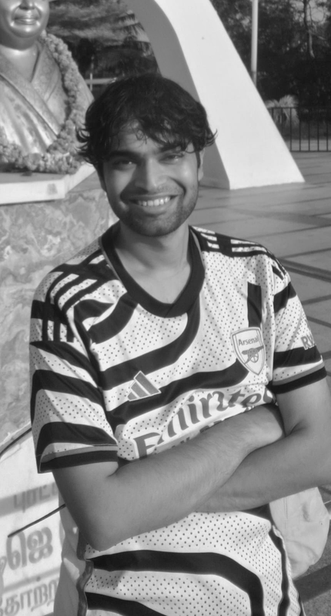
In Loving Memory
Ishan Kakodkar
“Sussegad”

Slide 4
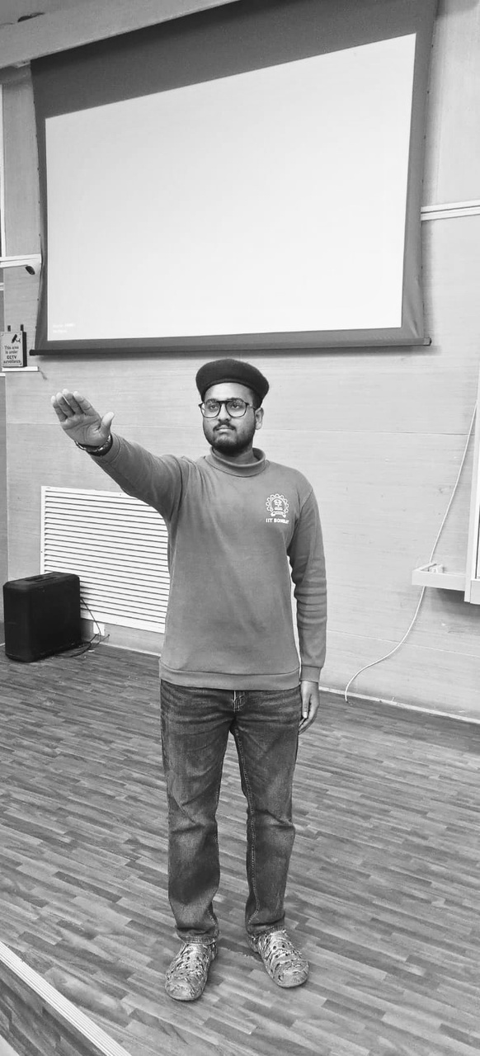
In Loving Memory
Kesav SS Ram
“I’ve been there!”

Slide 5



Join the groups to receive updates about upcoming quizzes/events

Slide 6
Pounce & Bounce
Bounce
  The question is put to one team first. If they can't answer, it "bounces" to the next team in order, and so on.
  No negative marking (+10/0)
  If the question completes a full round unanswered, it's dead and the answer is revealed.
Pounce
  At any point during/after the question is read (usually a 10s window), a team may "pounce" out of turn
  They can write their answer on paper and show it to the QM before the question is opened to the room.
  Once you pounce, you're out of the bounce for that question, whether right or wrong.
  Pounce carries negative marking (+10/-5)

Slide 7
Clockwise Round
  12 questions
  +10/0 for bounce
  +10/-5 for pounce
  Provide the complete answer for full points, on pounce
  Split scoring applicable, on bounce
  QM discretion is final
  Shoutout to Divyanshu & Ishan for GPing

Slide 8
1.
  In 1936, psychologist Kurt Lewin divided the world's social cultures into two types.
  _____ (5) cultures tend to be soft and friendly on the surface, even with strangers, but have a hard protective inner core.
  _______ (7) cultures present a tough shell to the world, resisting closeness and small talk, but reward patience with a softness within.
  Both types are named after the fruits whose physical structure mirrors these social architectures exactly.
  What is the model called?

Slide 9
safety slide

Slide 10
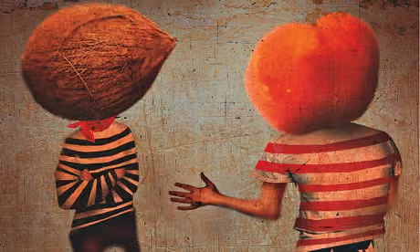
Peach and Coconut

Slide 11
2.
  At the Miami Art Museum, an interactive installation reimagines an indoor Olympic sport, where it’s net is replaced by a body of water. Players are warned not to reach in to retrieve balls that fall in, and not to continue playing with a wet ball if one does.
  What is the punny, onomatopoeic title of this installation?

Slide 12
safety slide

Slide 13
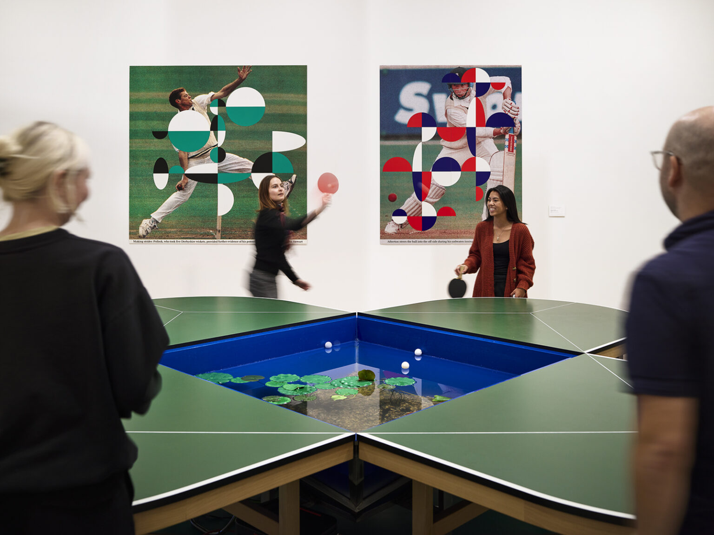
Ping Pond Table

Slide 14
3.
  In 1859, the Lyon chemist François-Emmanuel Verguin patented an aniline dye and named it after a flower [X]. This pendulous flower, discovered in the 1700s in Central and South America, was named after a German botanist, Leonard _____.
  Later that same year, Napoleon III's French forces beat the Austrians in the Battle of [Y]. Verguin's employer hastily renamed the dye after the town in Lombardy, where the battle was fought.
  Both names survived. [Y] dominated the 20th century and became a standard printing ink. [X] became trendy around the 2000s. Not to blush, but the dye featured significantly in a recent global event.
  Give [X] and [Y] essentially the same color.
(Pic follows)

Slide 15
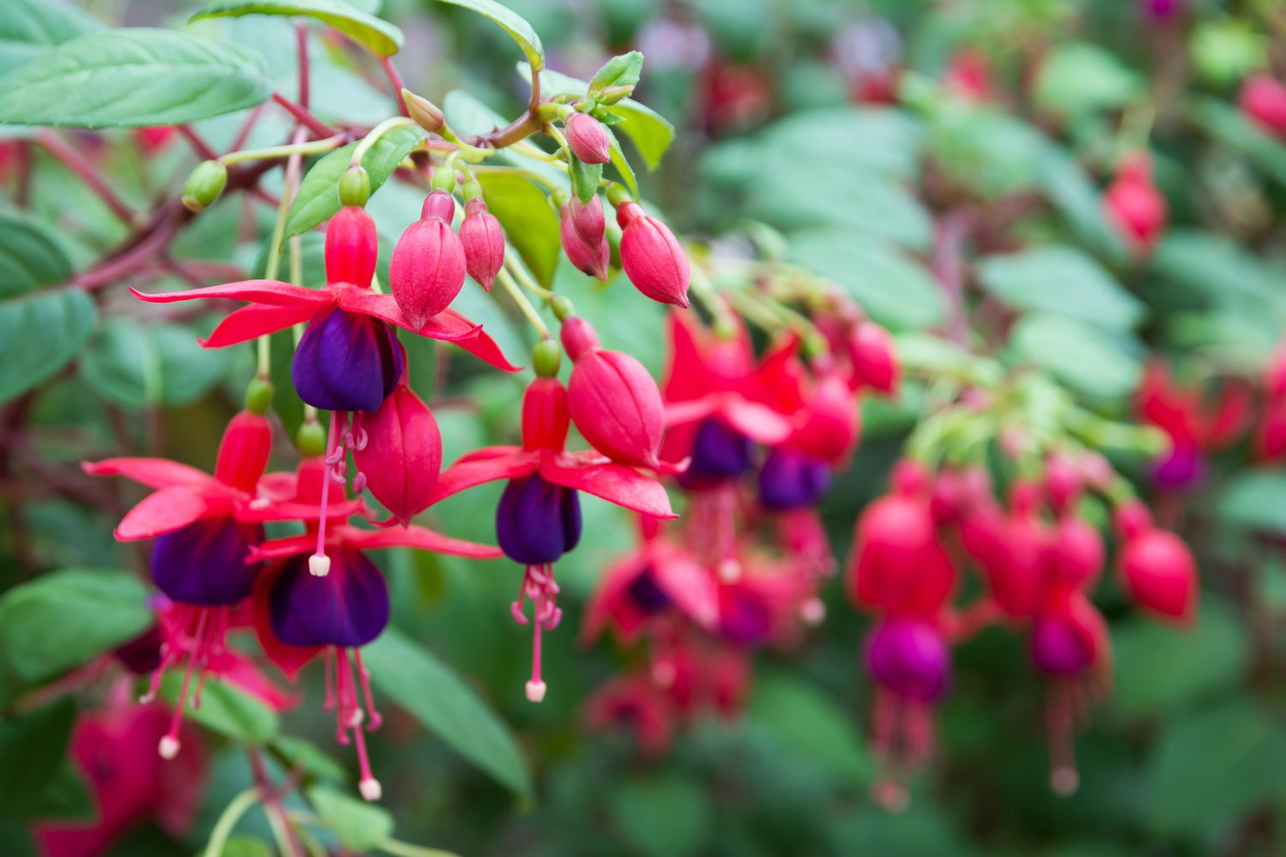

Slide 16
safety slide

Slide 17
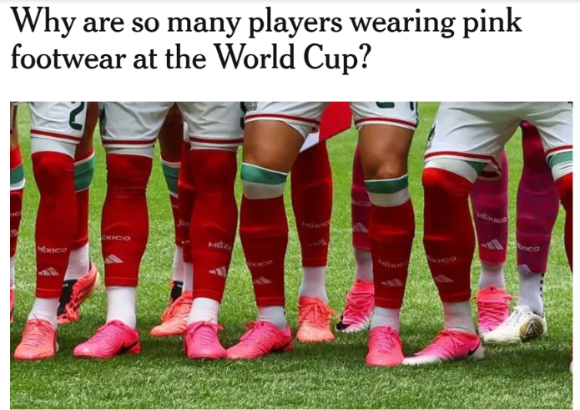
Fuchsia Pink, Magenta

Slide 18
4.
  When the Germans started using chlorine gas in WW1, the Allied soldiers found themselves in a dire situation. Knowing that ammonia could neutralize chlorine, they resorted to breathing through rags soaked in something, out of desperation.
  What naturally occurring elixir, did they soak the rags into?
  Soon, the Allied scientists experimented with materials that could trap poison gases. They discovered that the remnant of a common ingredient, when burnt, created a dense porous structure, which trapped the gas molecules before they reached the lungs.
  What commercial food item? The resulting product is a popular ingredient in the cosmetic industry.

Slide 19
safety slide

Slide 20
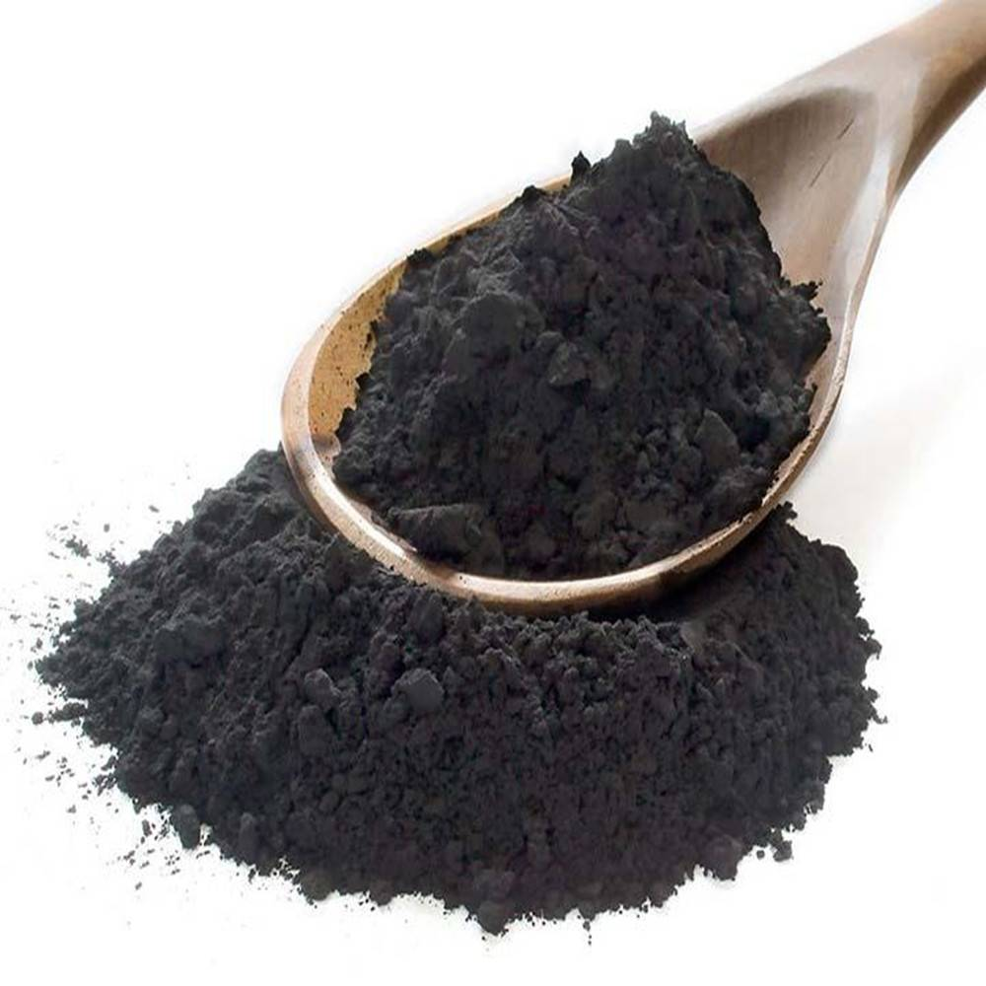
Urine; Coconut Shells/ Activated Charcoal

Slide 21
5.
  Surendra Mohan Bose was an Indian scientist who was imprisoned during WW1. While in jail, Bose came across accounts of Indian soldiers operating in difficult weather conditions, while imported products of this type remained expensive and largely inaccessible to ordinary Indians.
  His breakthrough came from an unlikely source, ducks. He observed how water effortlessly rolled off the duck’s feathers because of the natural oils covering them and started a brand on this unique waterproof technique.
  Name the eponymous brand? (nostalgic to a few)

Slide 22
safety slide

Slide 23
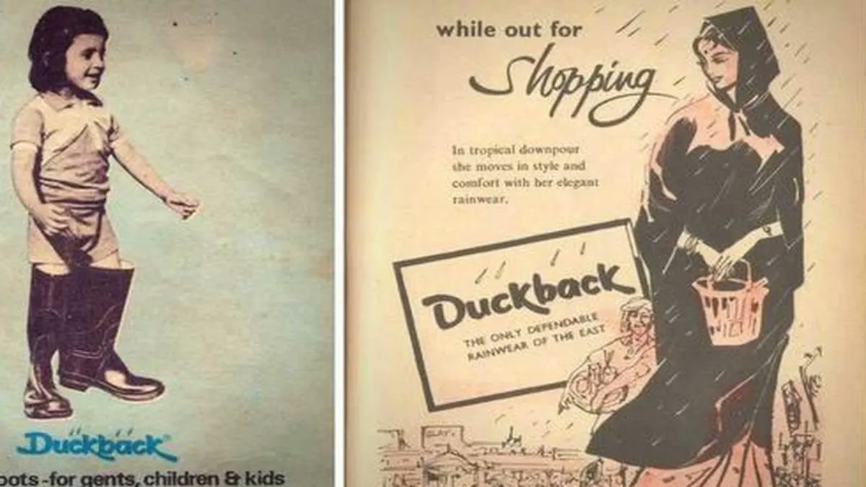
Duckback
The phrase "like water off a duck's back" inspired the brand name

Slide 24
6.
  Through the 1700s, the dominant coin in the Atlantic world was the Spanish silver dollar, written in ledgers as pesos. Clerks abbreviated it "PS".
  In fast handwriting, the s got written small and raised above the P - Pˢ. Over time, the two letters collapsed into each other and the loop of the P dropped away.
  This led to current day version of which symbol?

Slide 25
safety slide

Slide 26
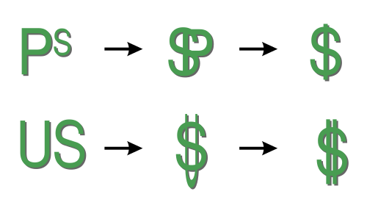
Dollar Sign $

Slide 27
7.
  This was originally used for visual-spatial measurements while driving. It was also a way to differentiate between different manufacturers.
  The luxury manufacturers transformed it from a vestigial to an aesthetic accessory, reflective of their brand identity. Despite the advent of sensors and other technology, this feature still remains in demand.
  In India, the government has repurposed this feature to project its commanding presence.
  What feature? How has the govt. repurposed it into?

Slide 28
safety slide

Slide 29
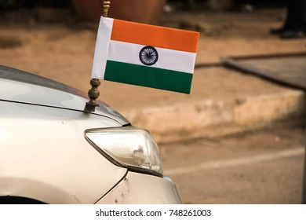
Hood ornament, Flag/Spike

Slide 30
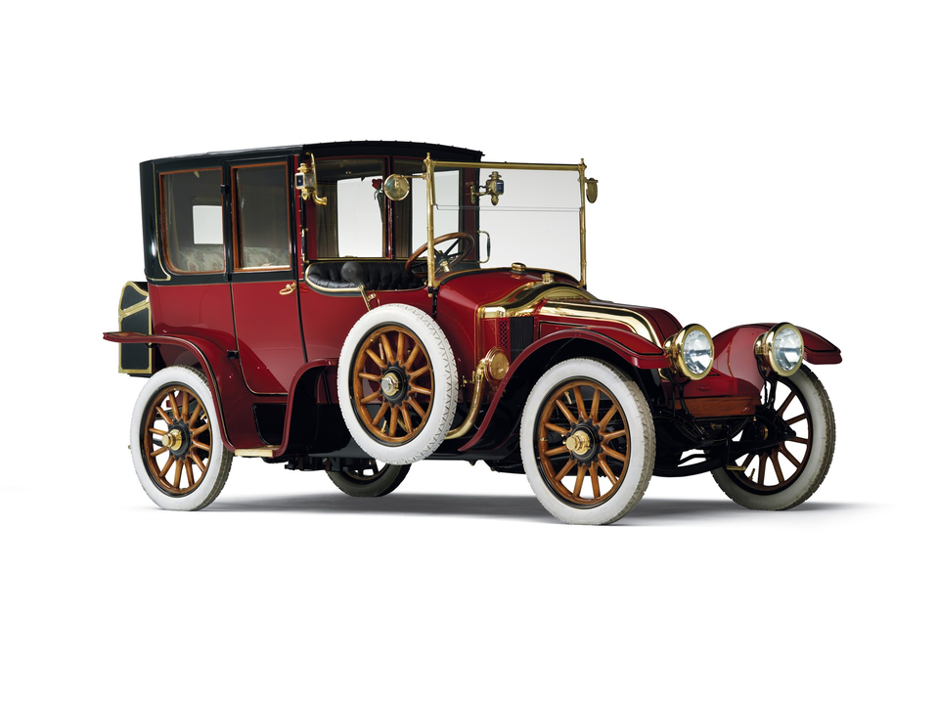
8.
  What is the significance of a Renault Type CB Coupé de Ville owned by William Carter of Pennsylvania?
  The 36-year-old Carter, wealthy heir to a coal & iron fortune, purchased the Renault while traveling from Europe with his wife and two children.

Slide 31
safety slide

Slide 32
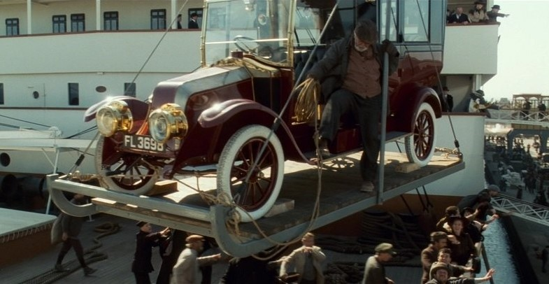
The car from RMS Titanic
Which also inspired THAT scene ;)

Slide 33
9.
  On 22 November 1950, the Fort Wayne Pistons beat the Minneapolis Lakers 19–18 (the lowest-scoring game in NBA history) by simply holding the ball and refusing to shoot. Attendance was spiraling.
  Danny Biasone, who owned the Syracuse Nationals (now Philadelphia 76ers), reckoned a watchable game contained about 120 field-goal attempts across 48 minutes. He did the maths and found a number. The league adopted his answer for the 1954–55 season and scoring rose by roughly fourteen points a game in a single year.
  What did Biasone's number give the sport?

Slide 34
safety slide

Slide 35
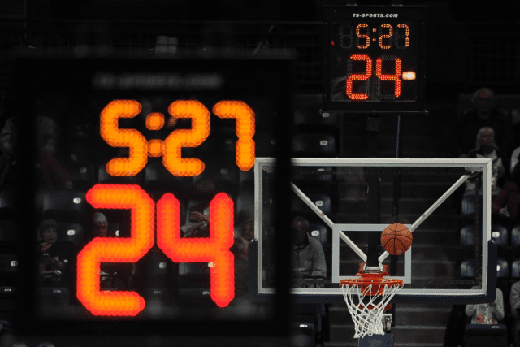
Shot clock / 24 second clock

Slide 36
10.
  According to Aristotle, the brain was merely a cooling radiator for the blood while the true seat of memory & intelligence lay in a different yet more important organ.
  His theory dominated European thought well into the Middle Ages, which is why medieval students committing texts to memory believed they were filing them in an organ that had nothing to do with it.
  Which phrase, still used in schools, is a remnant of this misconception?

Slide 37
safety slide

Slide 38
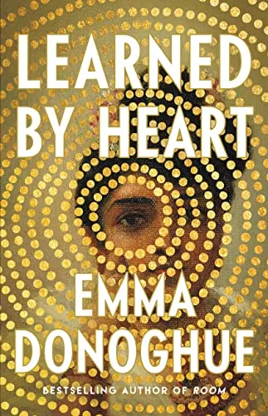
Learn by heart

Slide 39
11.
  New Zealand sports teams have an interesting naming scheme for their respective sports. Identify the missing ones.
  Cricket: Black Caps
  Rugby: All Blacks
  Basketball: ? (physical trait of most of its players)
  Badminton: ? (dropped in 2024 due to its NSFW nature)
  Lawn bowls: ? (also a casino card game)
  Lawn bowling is a sport in which players try to roll their ball as close as possible to a smaller jackball. The balls follow a curved path when being rolled.

Slide 40
safety slide

Slide 41

Tall Blacks; Black Cocks; Black Jacks

Slide 42
12.
  Goregaon Sports Club
  Parsi Dairy Farm
  Nino's Burger
  Poornima Restaurant
  Shalimar Hospitality
  Aparna Juhu Gymkhana
  Ajanta Caterers
  Maroosh
Non-exhaustive list of what?
Which famous Powai establishment is missing (need specific)?

Slide 43
safety slide

Slide 44

Licenses suspended by FDA

Slide 45
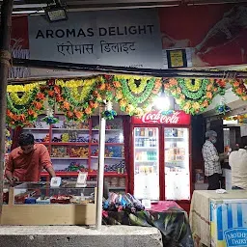
H1 & H3 hostel mess of IITB

Slide 46
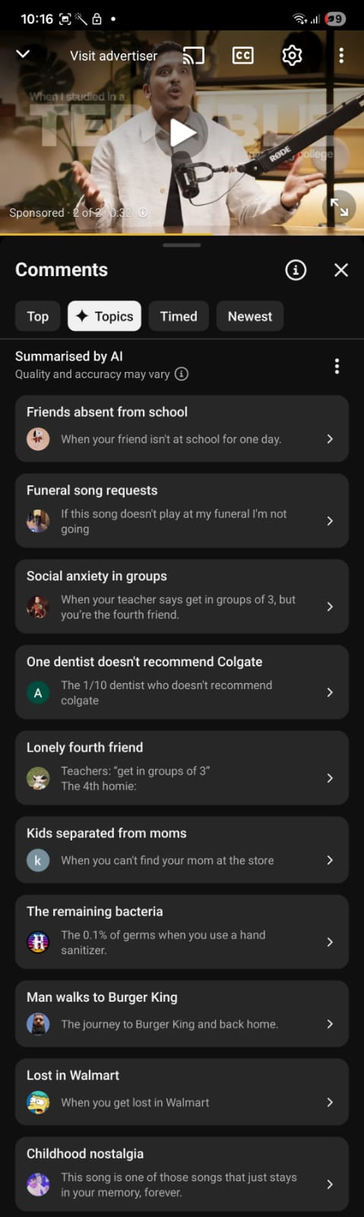
Written Round
  Identify the songs based on their YT comments
  6 Questions
  +10/0 for each answer

Slide 47
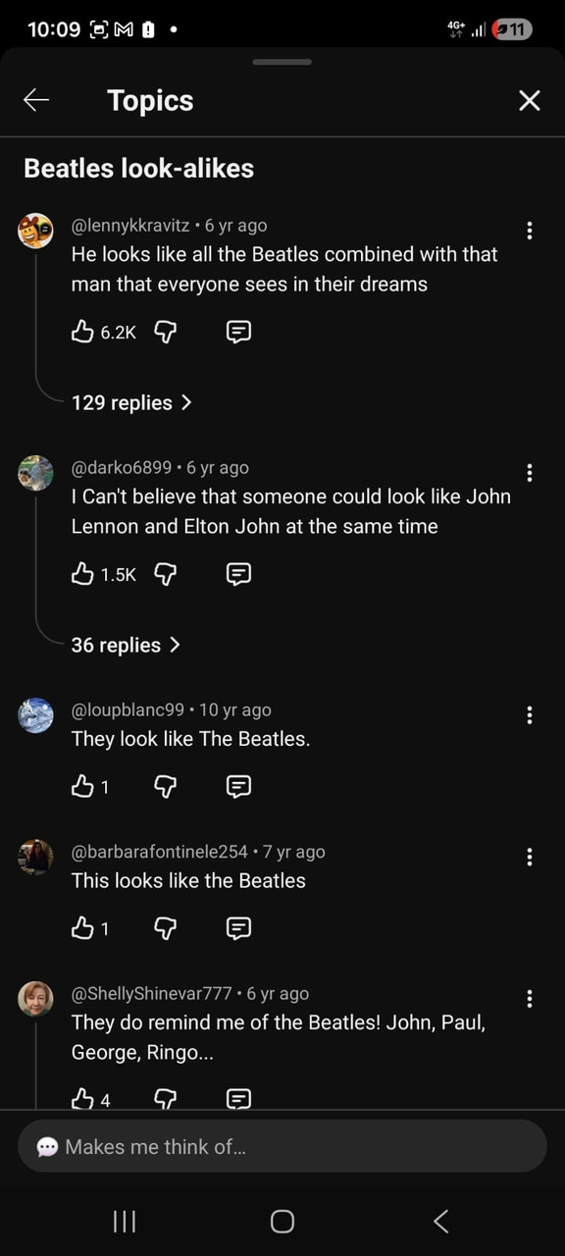
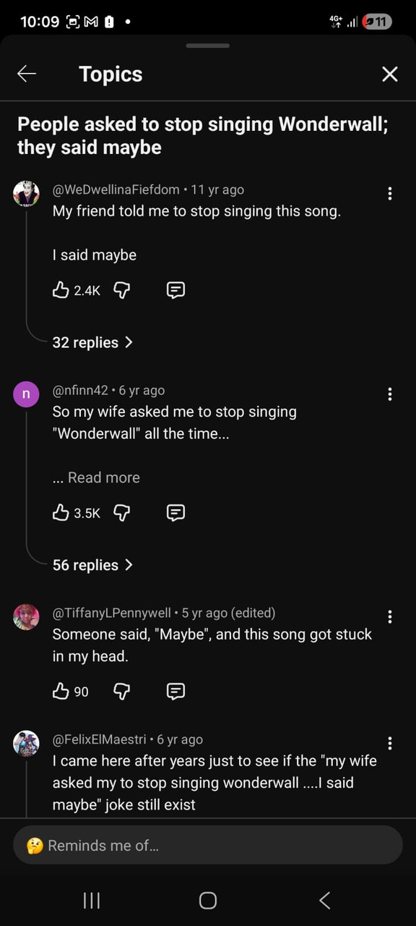
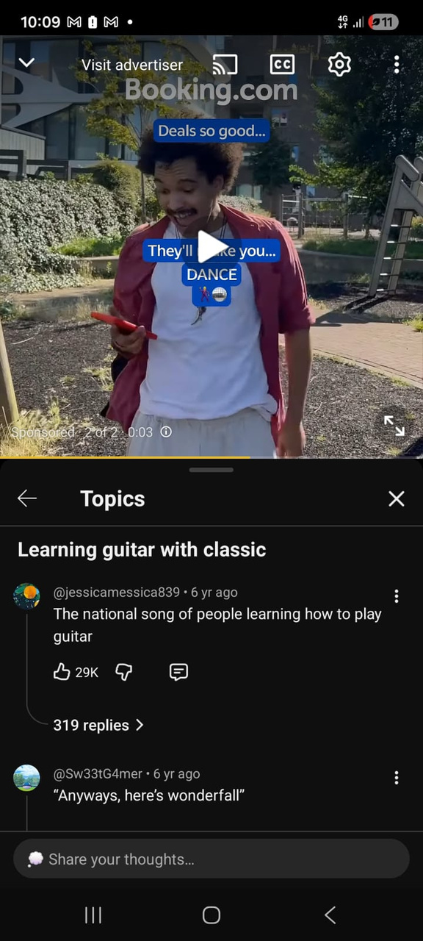
1.

Slide 48



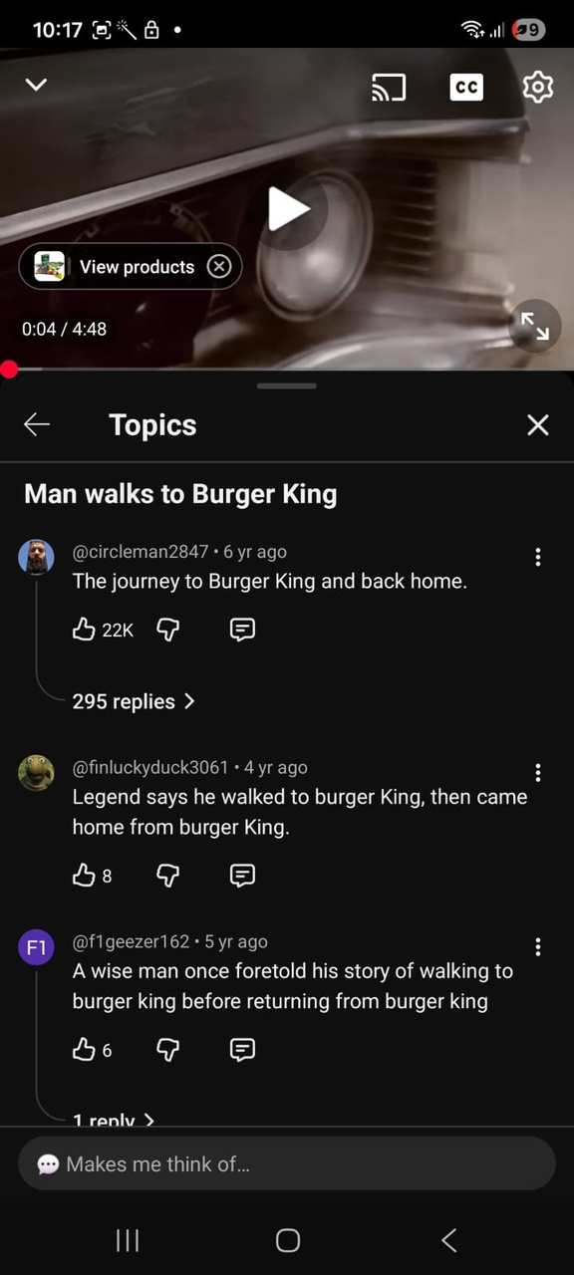
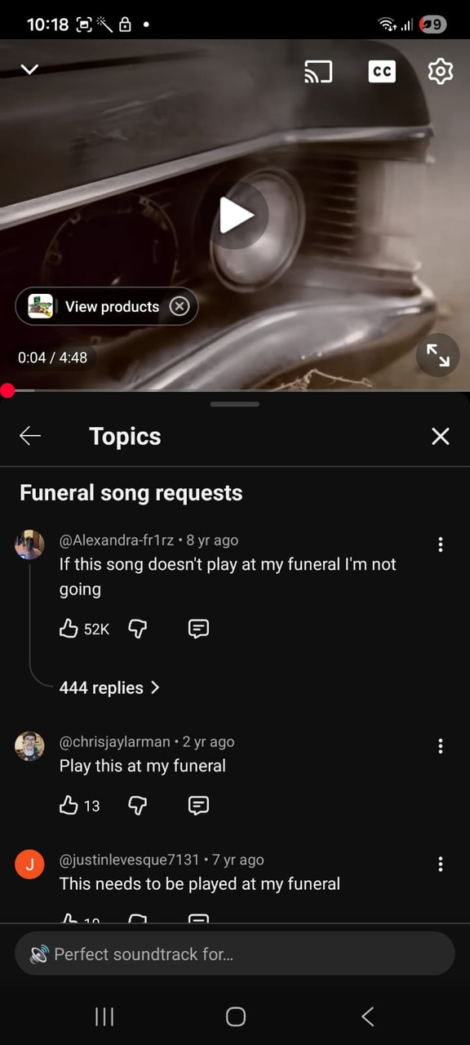
2.

Slide 49
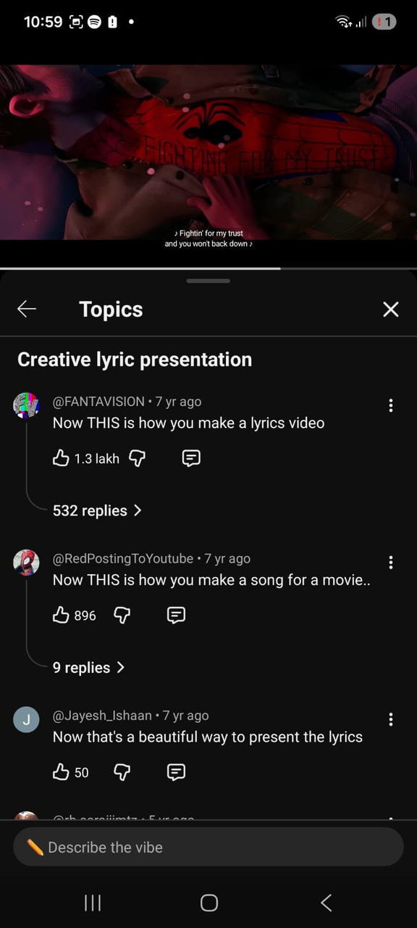
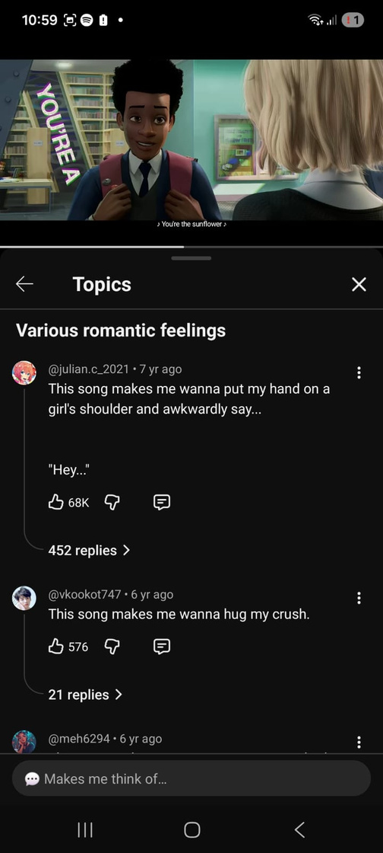
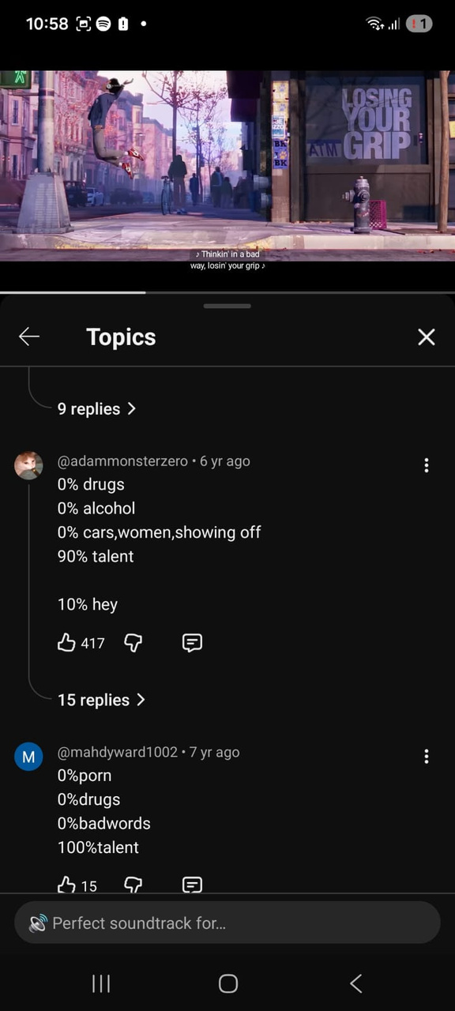
3.

Slide 50
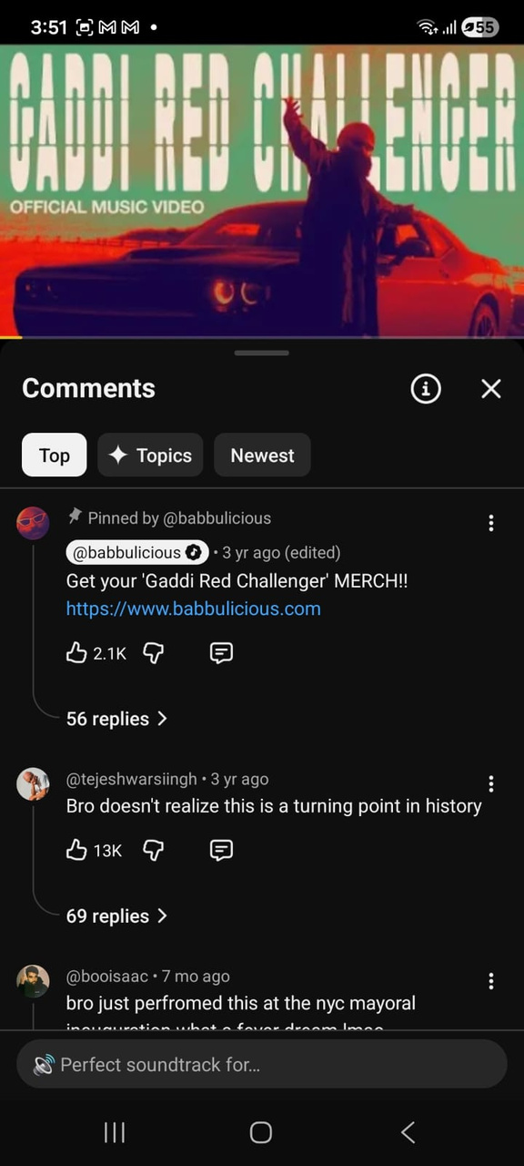
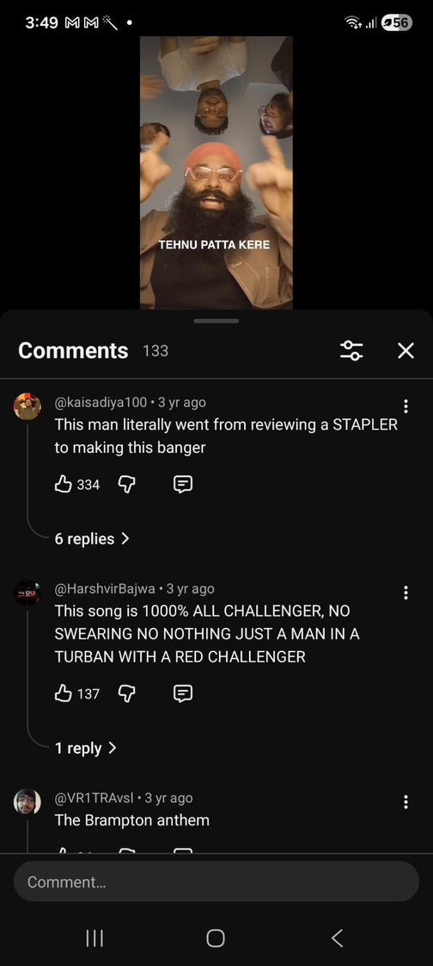
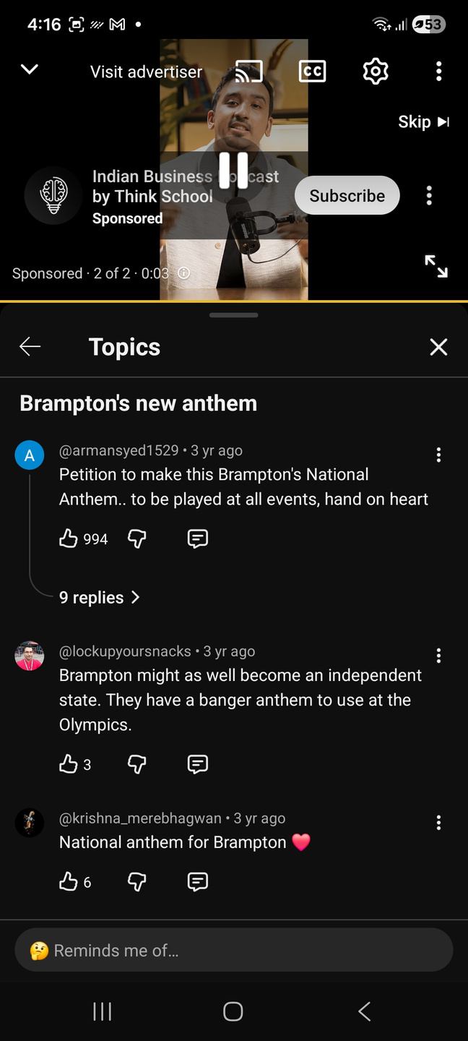
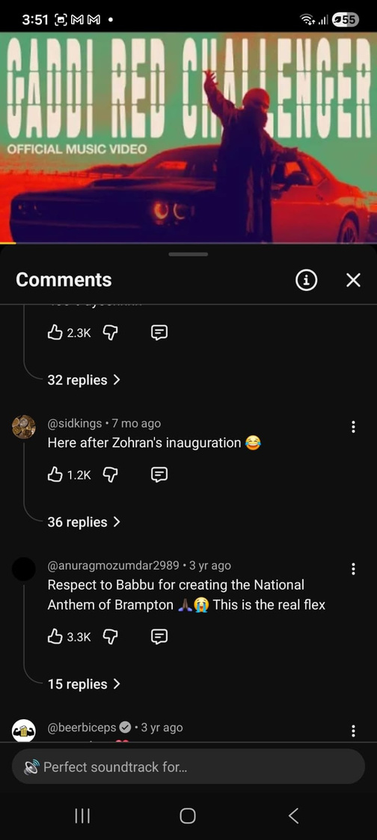
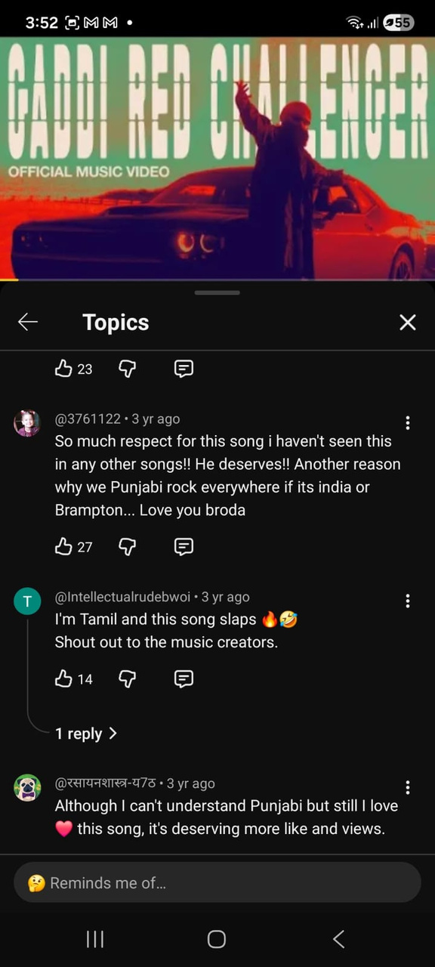
4.

Slide 51
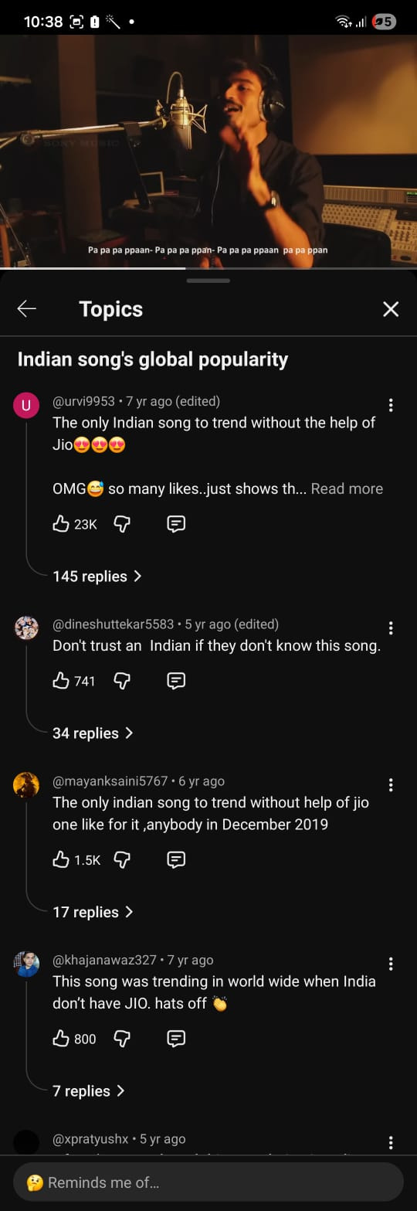
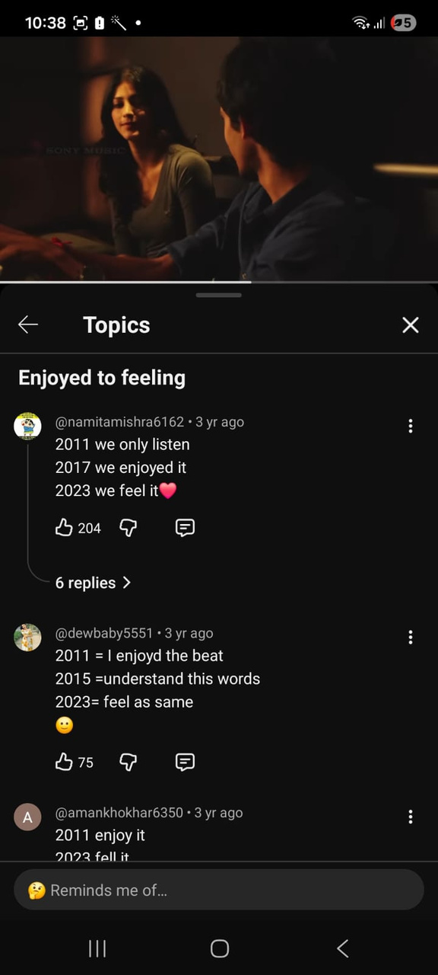
5.

Slide 52
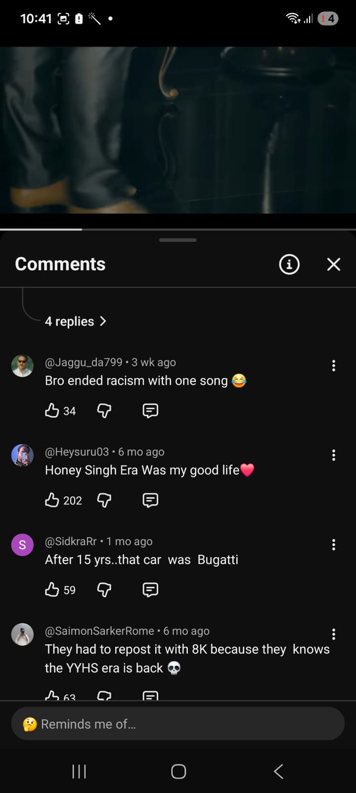
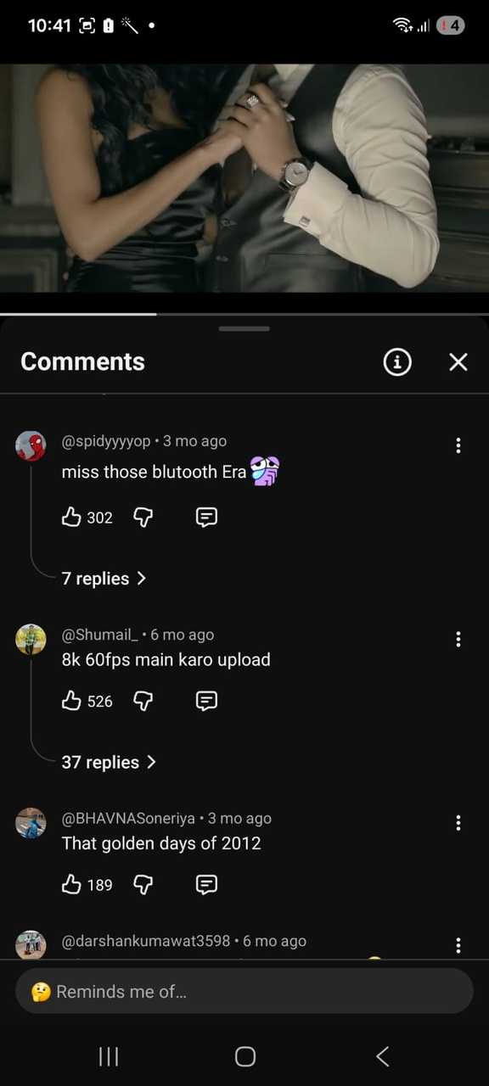
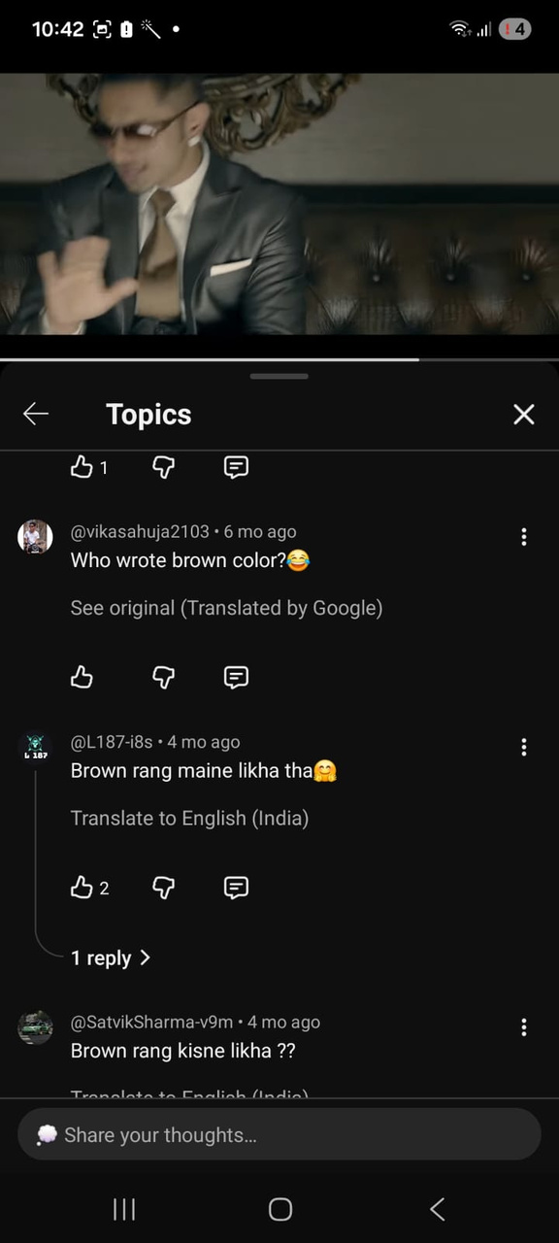
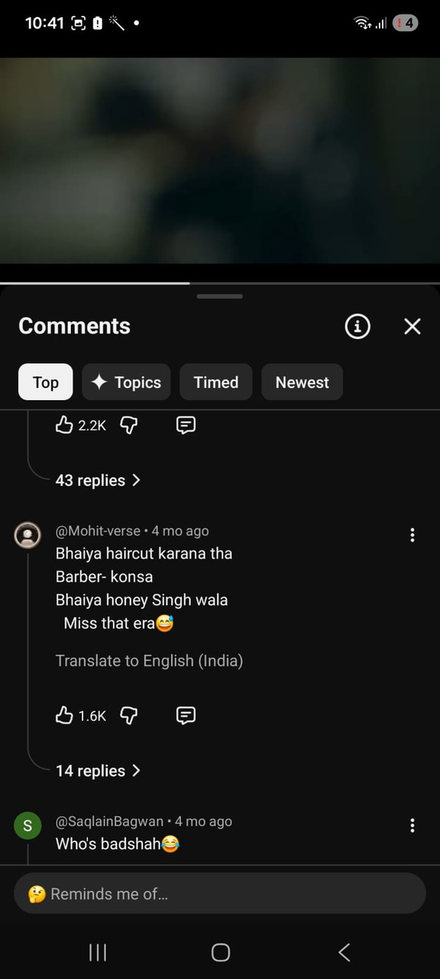
6.

Slide 53
exchange sheets

Slide 54
1.

Slide 55

Wonderwall by Oasis

Slide 56
2.

Slide 57
Boulevard of Broken Dreams by Green Day

Slide 58
3.

Slide 59
Sunflower by Post Malone, Swae Lee

Slide 60
4.

Slide 61
Gaddi Red Challenger by Babbu

Slide 62
5.

Slide 63
Why This Kolaveri Di

Slide 64
6.

Slide 65
Brown Rang by Yo Yo Honey Singh

Slide 66
Anti Clockwise Round
  12 questions
  +10/0 for bounce
  +10/-5 for pounce
  Provide the complete answer for full points, on pounce
  Split scoring applicable, on bounce
  QM discretion is final

Slide 67
1.
  A famous tourist spot in India is named for the convergence of four creeks. This spot has become iconic for a kind of street food.
  What is this place, which is slowly becoming a genericized word for any market thronged with food stalls in other cities in Central and Western India?

Slide 68
safety slide

Slide 69
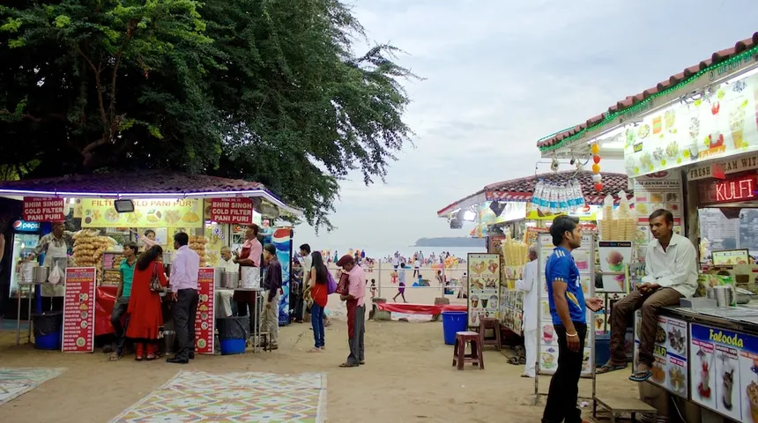
Chowpatty

Slide 70
2.
  When you go to [X].com, you are greeted by a prominent image (top pic). This website is currently managed by a company run by AI influencers.
  If you visit [Y].com, you are redirected to the home page of a learning company that was owned by Pearson until 2020 and if you visit [Z].com you land on a website (bottom pic) owned by a Dallas HQ company.
  Give X, Y and Z; the three terms are related. All of you have encountered it for at least a few years, at some point in your lives.
(Pic follows)

Slide 71


Slide 72
safety slide

Slide 73
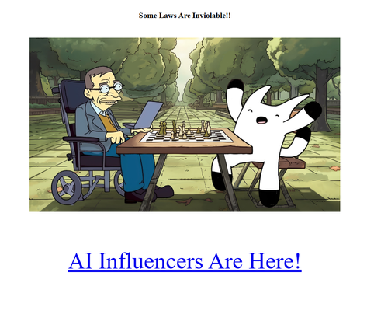


X - Physics, Y - Biology, Z - Chemistry

Slide 74
3.
  In 2016, Canadian chef Kelvin Cheung opened a nautically themed seafood restaurant in Mumbai. It became the default Bollywood A-list hotspot almost immediately and later spawned many branches.
  The name of this restaurant chain is inspired by a talking crab from the 1989 Disney animated film The Little Mermaid.
  Identify this brand.

Slide 75
safety slide

Slide 76


Bastian, from Sebastian

Slide 77
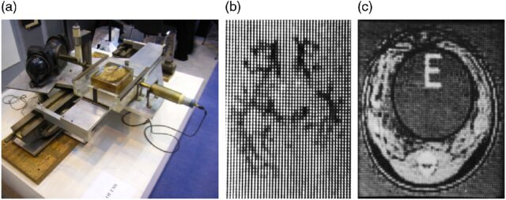
4.
  First instance of?

Slide 78
safety slide

Slide 79
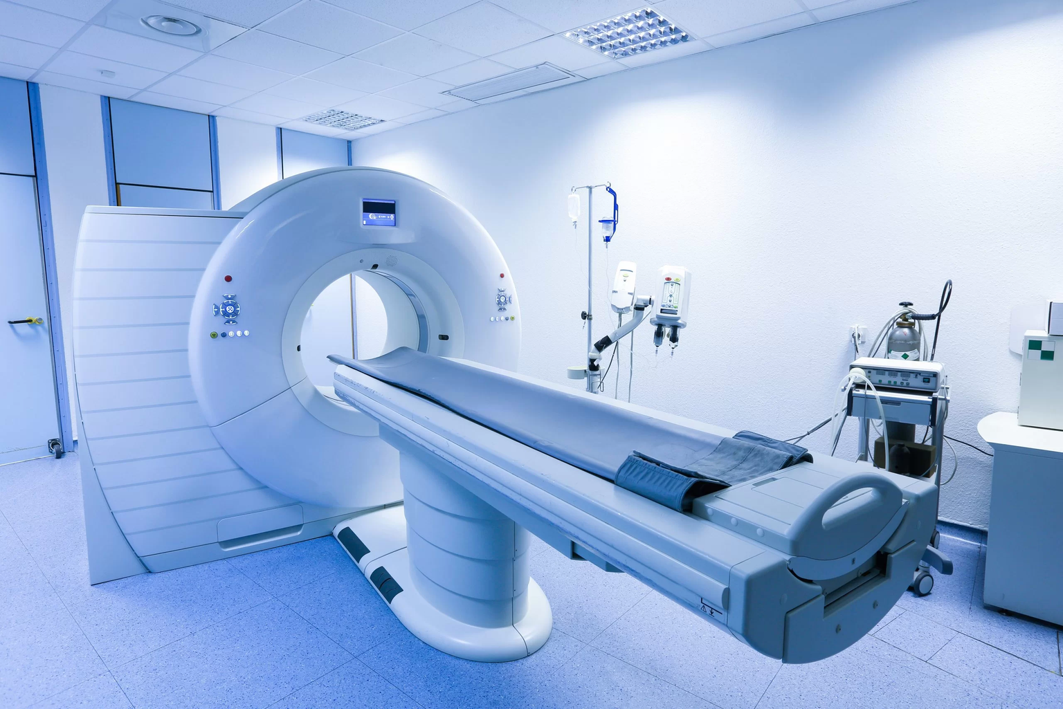
First-ever instance of CT scan

Slide 80
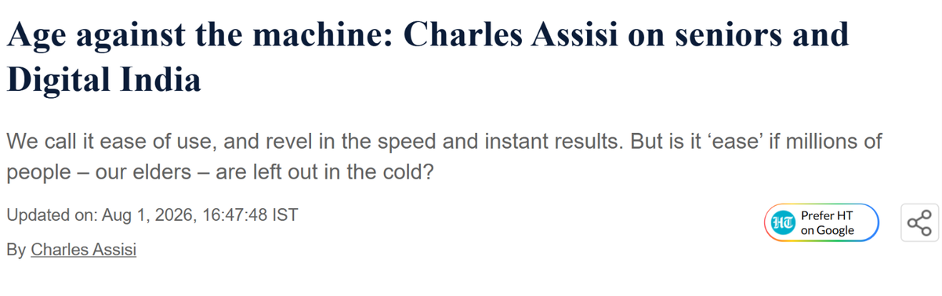
5.
  In August 2026, Hindustan Times ran a column on India's elderly struggling with OTPs and UPI. The headline was a pun on an American metal band's name, which also described how elders are coping with the complexities of automation and digital systems.
  Give me the headline

Slide 81
safety slide

Slide 82
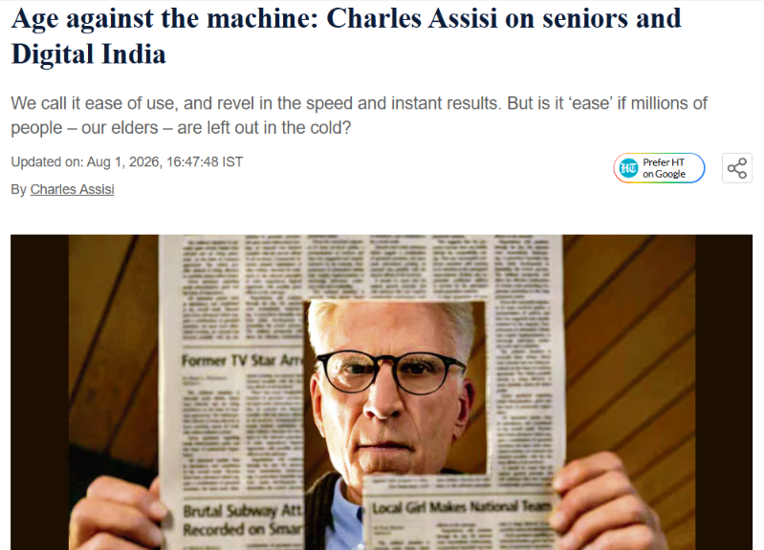
Age against the machine

Slide 83
6.
  Introduced in the Victorian era, this physical feature was present in the flagship products of the Big Four, helping people navigate their contents rather than fully peruse them. From the 20th century, as these products moved online, the feature became almost obsolete.
  In 2025, in its first revision in 22 years, one of the Big 4 (the only American one) insisted on retaining the obsolete physical feature purely out of nostalgia. The only US machine capable of doing them had shut down since it was last needed, so the work had to go to India.
  What feature?

Slide 84
safety slide

Slide 85
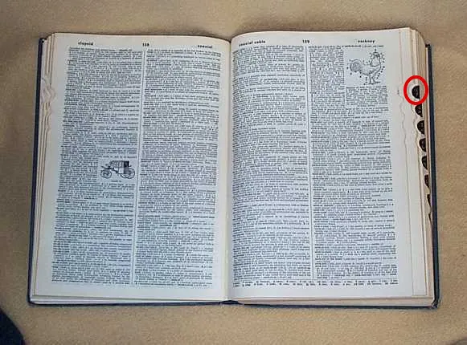
Thumb notches on dictionaries

Slide 86
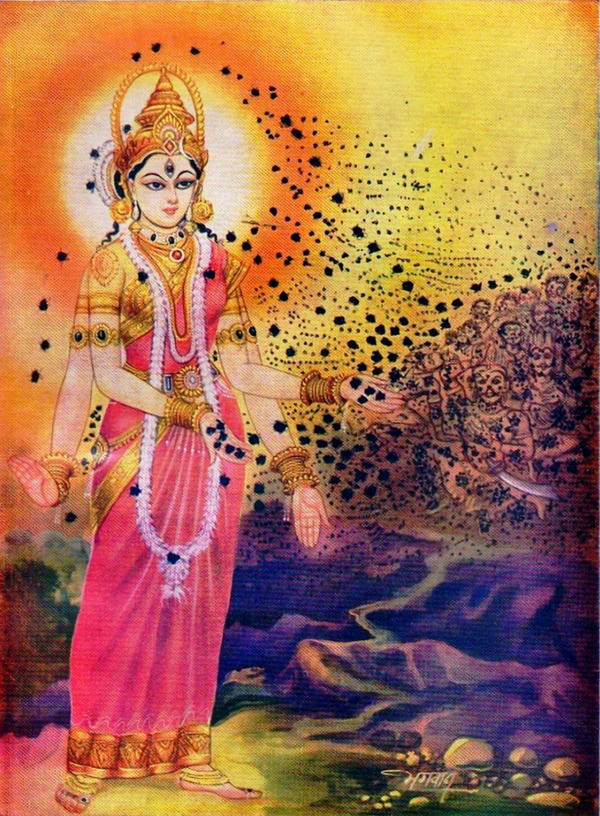
7.
  Bhramari, is a form of Shakti who is worshipped beside the Jyotirlinga at Srisailam.
  Her name is also given to a pranayama performed with a low humming exhalation.
  Who is she considered the goddess of?

Slide 87
safety slide

Slide 88
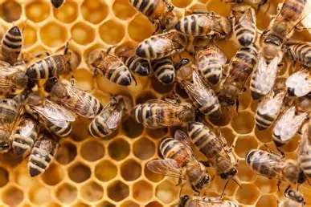
Bees

Slide 89
8.
  Until 1975, this Southeast Asian kingdom flew a red flag bearing a three-headed white elephant beneath a nine-tiered umbrella.
  Maha Sila Viravong, a scholar of literature and history, was asked in 1945 to produce something distinct from the royal standard. He took his cue from a neighboring country’s tricolor, which had displaced that country's own white-elephant flag.
  Identify the country [3]
  Which mythological creature does the former flag represent? [3]
  What does the blue band in the center of the present flag represent? [4]
(Pic follows)

Slide 90
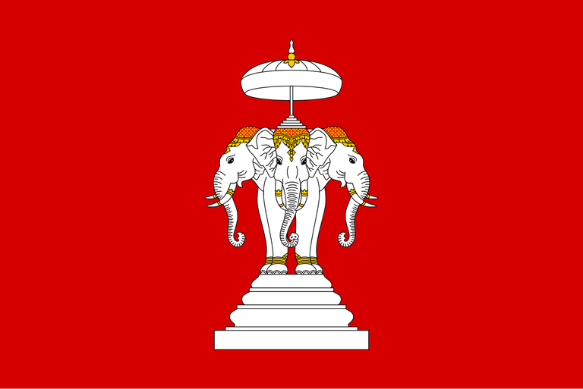
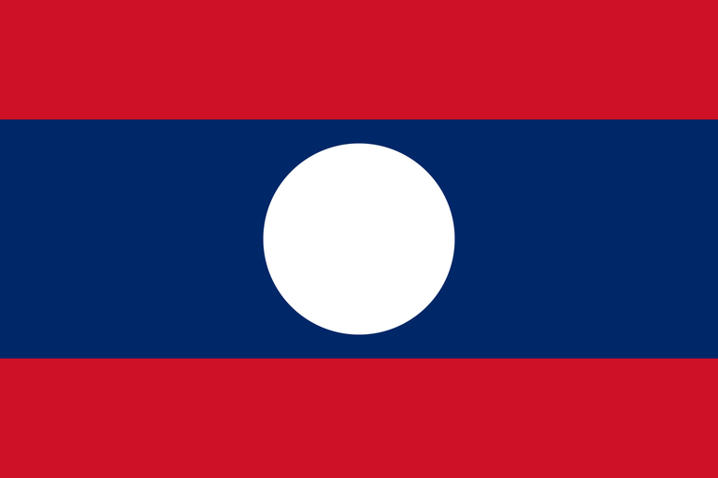

Slide 91
safety slide

Slide 92
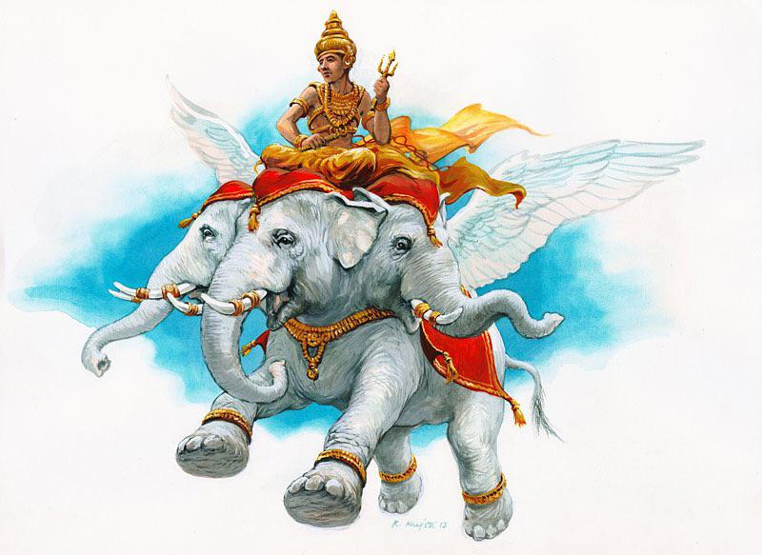
Laos; Airavat; Mekong river

Slide 93
9.
  In post-WWII Soviet Russia, Stalin’s government banned Western music, leaving fans desperate for alternatives. With this restriction and vinyl unobtainable, a sound engineer named Ruslan Bogoslovsky built a copy of a recording lathe and started pressing bootlegs onto the flexible plastic sheets available in bulk for free from hospital waste. The results were single-sided, played at 78 rpm, wore out after a few dozen plays, and had their spindle holes burned through with a lit cigarette.
  They carried jazz, rock and roll, tango and were sold hand to hand at flea markets. Over a million records were circulated.
  Because of what they were cut on, buyers could see ribs, skulls and shattered pelvises through the grooves, which gave the records their popular name.
  What were they made from and what were they called? [5+5]

Slide 94
safety slide

Slide 95

Discarded X-ray films; known as bone music or "ribs" (rebra)

Slide 96
10.
  A blazar is a supermassive black hole shooting out a jet of plasma at almost light speed. One of them, PKS 1424+240, was among the brightest gamma-ray and neutrino sources in the sky, yet its jet seemed to move slowly. After 15 years of research, astronomers at the Max Planck Institute found the jet is aimed almost perfectly at Earth. The slowness is a projection effect and the direct view boosts its apparent brightness.
  The nickname for this blazar comes from a mid-20th-century work of fiction that features a fiery, dangerous watcher whose gaze can only be turned in one direction at a time.
  What nickname/ fictional character?
(Pic follows)

Slide 97


Slide 98
safety slide

Slide 99

Eye of Sauron

Slide 100
11.
  The €500 is the highest-value euro banknote.
  It was nicknamed the ___ _____ because everyone knew it existed but nobody ever saw one. The ECB stopped issuing it in 2019 precisely because its main users were criminals.
  FITB

Slide 101
safety slide

Slide 102


Bin Laden

Slide 103
12.
  This building is an octagon with no prayer hall. At its center is not a floor but a bare outcrop of exposed bedrock.
  The mosaics carry some of the earliest dated Quranic inscriptions anywhere in the world. One band, over the inner arcade, is addressed directly to Christians, warning them not to say "Three."
  The Crusaders turned it into a church, faced the rock in marble and cut Latin texts over the Arabic. Salahuddin stripped all of that out after 1187.
  What building is this?
(Pic follows)

Slide 104


Slide 105
safety slide

Slide 106

Dome of the Rock (Qubbat al-Sakhra), Jerusalem

Slide 107

ty!

